Slide 1
Making this resource work for you
Prior to teaching this lesson, please refer to the ‘Unit Overview and Planning Document’.
Further guidance on planning Science Mastery lessons can be found in the detailed planning guidance document.
Refer to the ‘notes’ section on each slide for useful information, including suggested expositions, pedagogical content knowledge, suggested questions, answers and more. Consider using presenter mode so you can see this guidance throughout the lesson.
The introduction slides can be adapted to suit your teaching style and the needs of your class.
Before the lesson, adapt the fix-it slide to address any misconceptions identified in the previous lesson’s exit ticket.
Choose from the suggested activities to suit your class. The intention is not that you complete all of these, but that you select those which ones are most appropriate for your students. It may be appropriate to further adapt activities for your students.
These lessons are designed to occupy approximately 1 hour. To adapt for a shorter or longer lesson duration we advise you to adapt the activity section accordingly.
Please consider using the final slide to send feedback about this lesson or examples of PowerPoints that you have adapted to our design team. Your feedback is used to improve Science Mastery for all of our teachers and students. We appreciate all suggestions and comments.
Thank you for reading!
The Science Mastery Team

Slide 2

Cracking
Answer the questions below.
State the general equation for the combustion of alkanes.
Describe when incomplete combustion takes place.
Name the alkane with the chemical formula C₂H_{6.}
Describe what short chain hydrocarbons are used for.
Draw the structural formula for methane.
Alkane + oxygen → carbon dioxide + water
When there is a limited supply of oxygen.
Ethane
As fuels for heating or cooking
H
H
C
H
H
Notes:
Big idea: Reactions rearrange matter
Foundation: Define a hydrocarbon.
Stretch: Suggest why it is dangerous to keep a car running in a closed garage.
Answers:
Foundation: A molecule that contains carbon and hydrogen atoms only.
Stretch: The air supply will become limited, so incomplete combustion will take place, producing carbon monoxide which is toxic.

Slide 3
Cracking
Do Now:
State the general equation for the combustion of alkanes.
Describe when incomplete combustion takes place.
Name the alkane with the chemical formula C₂H_{6.}
Describe what short chain hydrocarbons are used for.
Draw the structural formula for methane.
Drill:
Determine how many hydrogen atoms would be in an alkane with 14 carbon atoms.
Determine how many hydrogen atoms would be in an alkane with 60 carbon atoms.
Determine how many carbon atoms would be in an alkane with 104 hydrogen atoms.
Notes:
Drill answers:
30
122
51

Slide 4
Cracking
Read Now:
According to a survey from 2022, there are about 1.45 billion cars in the world. That means that over 17 % of the human population has a car, but the cars are not spread evenly as some cars have many more cars than others. Many of these cars have petrol engines, which burn petrol as the fuel. Petrol contains relatively short chain hydrocarbons, such as octane (C₈H₁₈). As there is such high demand for these shorter hydrocarbons, some larger hydrocarbons can be broken down in chemical reactions to form these shorter chains. This type of chemical reaction is called cracking and produces a shorter chain hydrocarbon as well as another type of hydrocarbon called an alkene. Alkenes are also useful for many different things, including making plastics.
State how many cars there are in the world.
Name an alkane found in petrol.
Explain why there is high demand for petrol.
Describe what happens in a cracking reaction.
Name the other type of product from a cracking reaction.

Slide 5
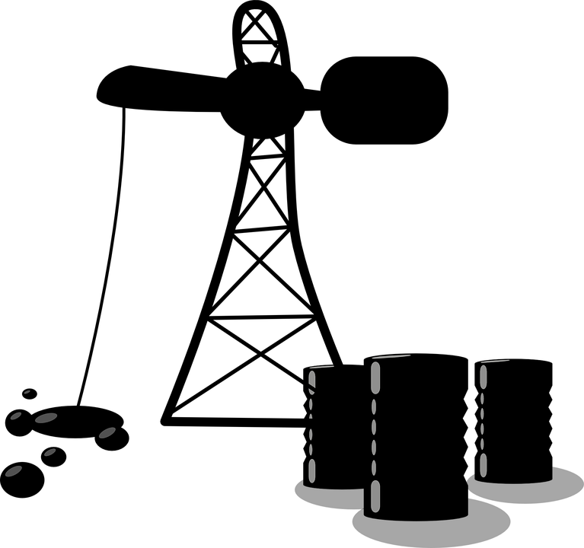
C5.1.5
15/08/2024
Cracking
C5.1.1 Prior Knowledge Review
C5.1.2 Crude Oil and Hydrocarbons
C5.1.3 Fractional Distillation
C5.1.4 Combustion of Hydrocarbons
C5.1.5 Cracking
C5.1.6 Taking it Further: Alkenes
C5.1.7 Taking it Further: Alcohols
C5.1.8 Taking it Further: Producing Ethanol by Fermentation
C5.1.9 Taking it Further: Producing Ethanol from Ethene
C5.1.10 Taking it Further: Carboxylic Acids
C5.1.11 Taking it Further: Esters
C5.1.12 Polymers
C5.1.13 Taking it Further: Addition Polymerisation
C5.1.14 Taking it Further: Condensation Polymerisation
C5.1.15 Taking it Further: Naturally Occurring Polymers
Notes:
Big Idea: Structure Determines Properties
In this lesson students will build on their understanding of hydrocarbons as fuels to look at how the issue of supply and demand of fuels is met using cracking. They will also be introduced to the other product of cracking which is alkenes. In this lesson, there is a brief overview of alkenes, including the difference in saturation, but most of the content for alkenes is chemistry only, which is covered in the next lesson.
Suggested Hook:
Shorter hydrocarbons are very useful as fuels.
How might we be able to get short hydrocarbons from longer hydrocarbons?
Would this be a physical change or a chemical reaction?

Slide 6

Following this lesson, students will be able to:
Determine the formulae of compounds produced from cracking
Explain why cracking is useful
Explain how bromine water can be used to distinguish between alkanes and alkenes
Key Words:
cracking
alkene
unsaturated
bromine water
conditions
steam
catalytic
Notes:
Guidance:
See unit overview document and planning guidance to see how these objectives are typically assessed at GCSE, including examples of what students should be able to do following this lesson.
Planning for different needs:
The learning objectives given on this slide are suggested based on the most common requirements for exams, however they can be adapted based on the needs of different classes.
For best practice, the unit preparation booklet should be used to determine the appropriate focus of lessons within the unit.
While it is not possible to explicitly split content into levelled grades, we recommend that lesson objectives can be classified as critical, core or stretch.
Critical: the content or skill is essential for all students to be able to progress.
Core: the content or skill is important for students to progress, but other opportunities may be available to revisit it.
Stretch: the content or skill may not be essential for all students but is important for students aiming for the highest grades.
Key skill: this is a crucial skill being developed in this unit as part of the skill mapping
C5.1.5 Lesson Objectives:
Critical: Determine the formulae of compounds produced from cracking
Core: Explain why cracking is useful
Critical: Explain how bromine water can be used to distinguish between alkanes and alkenes

Slide 7
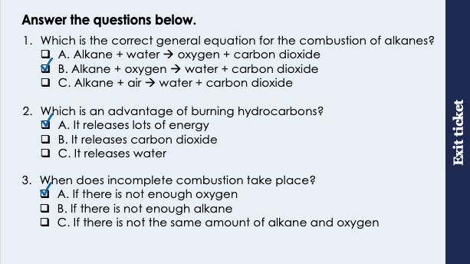
This is the fix-it portion of the lesson
The fix-it is an opportunity to respond to gaps in knowledge, especially those identified by the pre-unit quiz.
The teacher should customise this slide as needed, to facilitate
reteach, explanation, demonstration or modelling of ideas and concepts that students have not yet grasped or have misunderstood.
practise answering specific questions or of key skills.
redrafting or improving previous work.
Notes:
Purpose: to spend time on any gaps identified in previous learning from previous exit ticket.
Guidance from previous exit ticket:
Q1. Answer: B
If students answer A, they have confused reactants and products. If students answer C, they have the misconception that a substance reacts with air when it burns. To fix it, review what happens in a combustion reaction and review the general equation for combustion of alkanes.
Q2. Answer: A
If students answer B, they are not clear on why carbon dioxide production is a disadvantage. If students answer C, they have the misconception that we burn hydrocarbons to get water, rather than to release energy, which is a surprisingly common misconception based on the word equation. To fix it, review the advantages and disadvantages of burning hydrocarbons.
Q3. Answer: A
If students answer B, they have not recognised the correct limiting reactant. If students answer C, they have assumed that there need to be equal amounts for the reaction to fully take place. To fix it, it can be useful to show students with a quantitative example with oxygen as the limiting reactant.

Slide 8
Cracking
Small hydrocarbon chains are in high demand because they are highly flammable so are useful as fuels.
Larger hydrocarbon chains can be broken down to form smaller chains through a chemical reaction called cracking.
Hexane
→
Butane
+
Ethene
C₆H₁₄
C₄H₁₀
C₂H₄
H
H
H
H
H
H
H
H
H
H
H
H
H
C
C
H
→
C
C
C
H
+
C
C
C
C
C
C
H
C
H
H
H
H
H
H
H
H
H
H
H
H
Notes:
Suggested exposition:
In the last lesson, we looked at how hydrocarbons (like the alkanes) can be used as fuel through combustion reactions which release a lot of energy.
There is huge demand for smaller hydrocarbon molecules as they are more flammable than the larger molecules so are useful as domestic fuels for heating and cooking and for petrol. When crude oil is separated by fractional distillation, we get these different fractions, but some are more in demand than others. The supply is how much of a fraction an oil refinery produces. The demand is how much of a fraction customers want to buy. Very often, fractional distillation produces more of the larger hydrocarbons than can be sold, and less of the smaller hydrocarbons than customers want, so supply outweighs demand.
Larger molecules can be broken down using a chemical reaction to produce smaller, more useful molecules.
This type of reaction is called cracking. Since cracking converts larger hydrocarbons into smaller hydrocarbons, the supply of these small molecules is increased. This also means that supply of the larger molecules is decreases, so supply and demand of all hydrocarbons can be more closely matched.
During cracking, a long alkane is broken down to form a shorter alkane and another product called an alkene. Alkenes are members of another homologous series (a family of compounds with the same functional group).
For example, hexane can be broken down to form butane and an alkene called ethene.
Animate hexane and butane.
Remember in a chemical reaction that atoms cannot be created or destroyed. We can use this to determine the chemical formula of ethene.
How many carbons are in hexane?
6
How many carbons are in butane?
4
Therefore how many carbons must be in ethene?
2
How many hydrogens are in hexane?
14
How many hydrogens are in butane?
10
Therefore how many hydrogens must be in ethene?
4
This means that ethene has the chemical formula C₂H₄.
As with the alkanes, where the prefix eth- means two carbons, the same is true here. But this time, we have an alkene rather than an alkane, so it ends ethene rather than ethane.
So how can it have the formula C₂H₄ while still having full outer electron shells?
There is a double bond between the carbon atoms. This double bond is the functional group of the alkenes, so all alkenes have a carbon-carbon double bond.
What is the general formula for the alkanes?
C_{n}H2_{n+2}
Using the formula of ethene, can you suggest what the general formula of the alkenes is?
C_{n}H_{2n}.

Slide 9
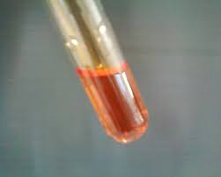
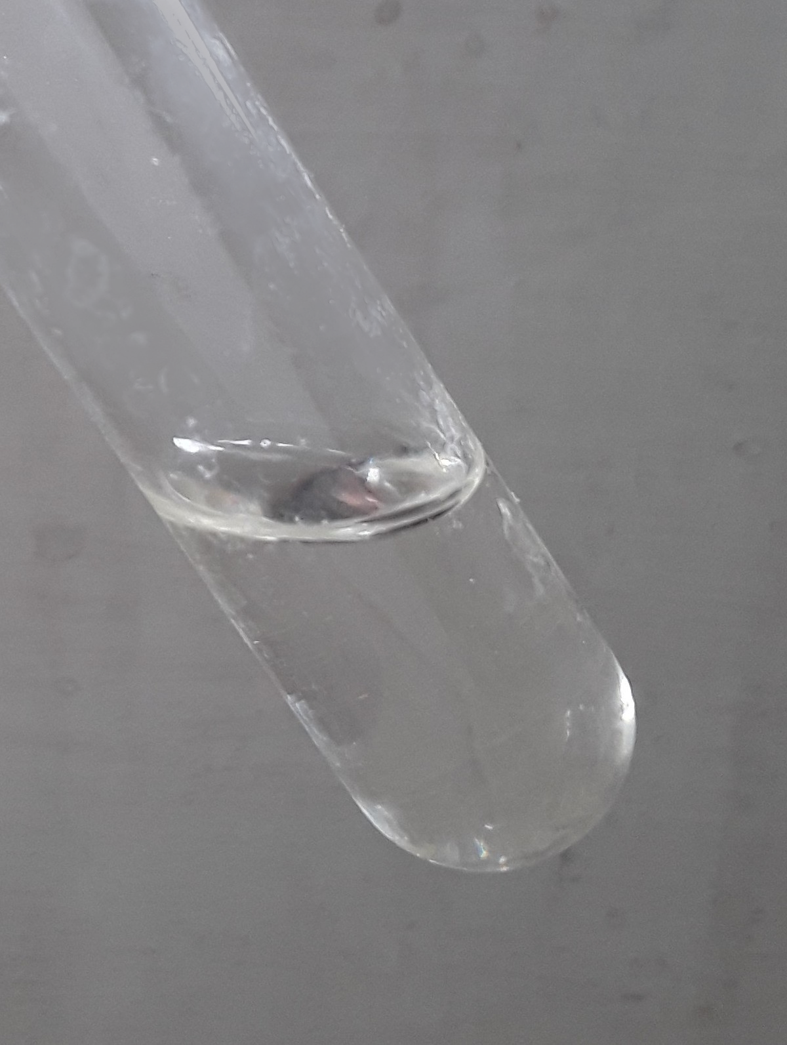
Testing for Alkenes
H
H
H
H
H
C
C
H
C
C
H
H
H
H
Alkane
Alkene
saturated
unsaturated
Add bromine water
Stays orange
Turns colourless
Notes:
Suggested exposition:
So cracking is important because it helps to match supply for smaller fractions with demand. The alkene product of cracking is also useful as they are used as feedstocks in the petrochemical industry, which means they can be used in the production of many other chemicals, including things like plastics, which we will look at later in this unit.
So how can we tell the difference between alkanes and alkenes in the products of a cracking reaction?
Alkanes have all single bonds between the carbon atoms, so they can be described as saturated, because no more bonds can be made.
Alkenes however have a double bond between carbon atoms, so they are unsaturated. The double bond can be broken and more bonds can be made.
An easy way to remember the difference is that alkene has two ‘E’s so two bonds.
We can use bromine water to tell the difference between alkanes and alkenes.
Bromine water is orange.
When bromine water is added to an alkane, the alkane cannot react with it as it is saturated so it cannot make bonds with the bromine atoms. This means that the bromine stays orange.
When bromine water is added to an alkene, the double bond is broken as the bromine reacts with the alkene, forming a new compound. This makes the bromine turn colourless.
Because alkenes are more reactive than alkanes, they can take part in chemical reactions that alkanes cannot, which is why they are useful as feedstocks in the petrochemical industry.
Note: in the following lesson, chemistry only students will look at these reactions in more detail.
Image source:
CC@https://commons.wikimedia.org/wiki/File:Brominewater.jpg
CC@https://commons.wikimedia.org/wiki/File:Toluen.png

Slide 10
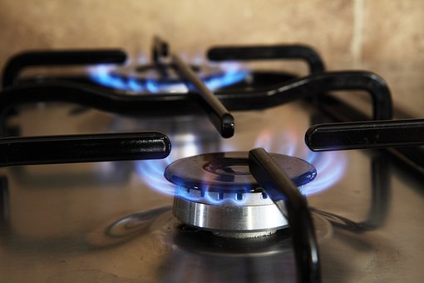
Conditions for Cracking
Cracking is the chemical reaction where a longer chain alkane is broken down to form a shorter chain alkane and an alkene.
It can be carried out using different methods and reaction conditions:
Catalytic cracking involves a temperature of 550 ºC and a catalyst called a zeolite
Steam cracking involves a temperature of 850 ºC and no catalyst
Notes:
Suggested exposition:
Cracking is the reaction where a longer chain alkane is broken down to form a shorter chain alkane and an alkene.
There are different methods that can be used for cracking:
catalytic cracking uses a temperature of approximately 550 °C and a catalyst called a a zeolite. This contains a mixture of aluminium oxide and silicon oxide, both of which work to speed up the reaction, which is why the reaction can take place at a lower temperature than…
steam cracking, which uses a higher temperature of approximately 850 °C and no catalyst
Image from pixabay

Slide 11




Which statements do you agree with?
Alkanes turn bromine water colourless
Alkenes turn bromine water cloudy
Alkenes turn bromine water colourless
Alkanes do not react with bromine water, so it stays orange
Notes:
Suggested points:
This talk task is designed to ensure that students are clear on the properties of the different fractions, drawing out if they understand the difference between high and low volatility and viscosity.
Blue: incorrect - this is a common misconception with the test for a C=C double bond and the test for carbon dioxide
Yellow: incorrect
Green: correct
Pink: correct
Suggested guidance:
Talk tasks can be used in a variety of ways to suit the particular needs of the students you are teaching. Through exchanging views with others, students develop their understanding of the science beyond what could be achieved individually.
Science classrooms that successfully integrate talk have the following features:
Science talk is a regular feature of lessons and is woven into classroom activities.
Students are paired or grouped strategically by the teacher to ensure productive interaction. This might take into consideration the students’ proficiency of the English language, how encouraging they might be to peers and their attainment in the topic. It’s a good idea to consider these pairings in the class seating plan.
Students are encouraged and supported to talk, but are not forced to talk.
The teacher should take on the role of a facilitator, engaging with conversations where necessary and encouraging or steering the conversation where needed.
Students are encouraged to use the language they have to express their ideas (e.g., everyday language, imperfect English, native language), but also to incorporate science specific terminology where this is more accurate or has been taught.
6. Scientifically inaccurate ideas are not dismissed by the partner or teacher; open discussion and further investigation are relied on to help students construct ideas that support them to progress in their scientific understanding.
7. Guidelines for behaviour during talk tasks are explicit and frequently reviewed. Rules for students might be:
Listen carefully to your partner
Take turns talking.
Speak one at a time, without interrupting.
Politely agree or disagree and explain why.
Politely point out if your partner has used a scientific word incorrectly, if they have explained the science incorrectly, or if there is a more accurate way to describe something.
If confused, ask questions.
Stay focused on the discussion topic.
Respond to one another.

Slide 12
Is this correct?
Cracking and fractional distillation are both physical processes
Notes:
Suggested guidance:
Fractional distillation is a physical process as it uses the different boiling points to separate the mixture of crude oil, but no new substances are made so it is not a chemical reaction.
Cracking is a chemical reaction because a new substance is made.
Suggested guidance:
Talk tasks can be used in a variety of ways to suit the particular needs of the students you are teaching. Through exchanging views with others, students develop their understanding of the science beyond what could be achieved individually.
Science classrooms that successfully integrate talk have the following features:
Science talk is a regular feature of lessons and is woven into classroom activities.
Students are paired or grouped strategically by the teacher to ensure productive interaction. This might take into consideration the students’ proficiency of the English language, how encouraging they might be to peers and their attainment in the topic. It’s a good idea to consider these pairings in the class seating plan.
Students are encouraged and supported to talk, but are not forced to talk.
The teacher should take on the role of a facilitator, engaging with conversations where necessary and encouraging or steering the conversation where needed.
Students are encouraged to use the language they have to express their ideas (e.g., everyday language, imperfect English, native language), but also to incorporate science specific terminology where this is more accurate or has been taught.
6. Scientifically inaccurate ideas are not dismissed by the partner or teacher; open discussion and further investigation are relied on to help students construct ideas that support them to progress in their scientific understanding.
7. Guidelines for behaviour during talk tasks are explicit and frequently reviewed. Rules for students might be:
Listen carefully to your partner
Take turns talking.
Speak one at a time, without interrupting.
Politely agree or disagree and explain why.
Politely point out if your partner has used a scientific word incorrectly, if they have explained the science incorrectly, or if there is a more accurate way to describe something.
If confused, ask questions.
Stay focused on the discussion topic.
Respond to one another.

Slide 13
Drill
Explain the difference between supply and demand.
Describe what happens during cracking.
Name the two types of product produced through cracking.
Give two reasons why cracking is useful.
Describe what happens when bromine water is added to alkanes.
Describe what happens when bromine water is added to alkenes.
Explain why alkenes are described as unsaturated.
Name two different methods of cracking.
Describe the conditions needed for catalytic cracking.
Describe the conditions needed for steam cracking.
Notes:
Purpose: This is a knowledge drill. The purpose of this is to check that the critical knowledge is secure before pupils move onto independent practice.
Suggested guidance: There are a range of ways this could be done depending on time and ability range of the class:
Mini whiteboards
As full sentences in exercise books
As short answers in exercise books
In the pupil workbook
As pair talk
As cold call

Slide 14
Drill answers
Supply is how much of something is produced whereas demand is how much of something is needed.
A longer chain hydrocarbon is broken down to make a shorter chain hydrocarbon.
A (shorter chain) alkane and an alkene
It increases supply of the smaller molecules used for fuels and it produces alkenes which are used as feedstocks in the petrochemical industry.
Bromine water stays orange.
Bromine water turns colourless.
They contain a C=C double bond.
Catalytic cracking and steam cracking
A temperature of 550 ºC and a catalyst
A temperature of 850 ºC
Notes:
Purpose: This is a knowledge drill. The purpose of this is to check that the critical knowledge is secure before pupils move onto independent practice.
Suggested guidance: There are a range of ways this could be done depending on time and ability range of the class:
Mini whiteboards
As full sentences in exercise books
As short answers in exercise books
In the pupil workbook
As pair talk
As cold call

Slide 15
I: Determining the products of cracking
Dodecane (C₁₂H₂₆) is cracked to produce octane (C₈H₁₈).
C₁₂H₂₆ → C₈H₁₈ + __________
What is the chemical formula for the other product formed?
C₄H₈
What homologous group does the other product belong to?
Alkenes
Explain how you could tell the difference between the two products once they were separated.
Add bromine water to each. Octane will cause the bromine water to stay orange and the alkene will turn the bromine water colourless.
Explain why it is useful to crack dodecane.
There is greater demand for shorter molecules like octane, as they can be used as fuels.
Notes:
Purpose: The I-We-You section aims to support pupils to build skills that they most commonly need when answering questions associated with this knowledge in the assessment. This section is also used to interleave other content we expect pupils to know at this stage of their education in order that they build a big picture of the science they are learning.
For the ‘I’ activity, the teacher should model how to answer the question. They can do this by narrating their thinking process aloud, and making links to learning earlier in the lesson explicit.
For the ‘we’ activity, the teacher and students work though a similar example together, in order to prepare students to be able to answer a similar question independently.
Opportunities for the ‘you’ activity – independent practise – occur in the activity portion of the lesson once the student is secure enough to process independently.

Slide 16
We: Determining the products of cracking
Decane (C₁₀H₂₂) is cracked to produce heptane (C₇H₁₆).
C₁₀H₂₂ → C₇H₁₆ + __________
What is the chemical formula for the other product formed?
C₃H₆
What homologous group does the other product belong to?
Alkenes
Explain how you could tell the difference between the two products once they were separated.
Add bromine water to each. Heptane will cause the bromine water to stay orange and the alkene will turn the bromine water colourless.
Explain why it is useful to crack decane.
There is greater demand for shorter molecules like heptane, as they can be used as fuels.
Notes:
Purpose: The I-We-You section aims to support pupils to build skills that they most commonly need when answering questions associated with this knowledge in the assessment. This section is also used to interleave other content we expect pupils to know at this stage of their education in order that they build a big picture of the science they are learning.
For the ‘I’ activity, the teacher should model how to answer the question. They can do this by narrating their thinking process aloud, and making links to learning earlier in the lesson explicit.
For the ‘we’ activity, the teacher and students work though a similar example together, in order to prepare students to be able to answer a similar question independently.
Opportunities for the ‘you’ activity – independent practise – occur in the activity portion of the lesson once the student is secure enough to process independently.

Slide 17
You: Determining the products of cracking
Octane (C₈H₁₈) is cracked to produce hexane (C₆H₁₄).
C₈H₁₈ → C₆H₁₄ + __________
What is the chemical formula for the other product formed?
C₂H₄
What homologous group does the other product belong to?
Alkenes
Explain how you could tell the difference between the two products once they were separated.
Add bromine water to each. Hexane will cause the bromine water to stay orange and the alkene will turn the bromine water colourless.
Explain why it is useful to crack octane.
There is greater demand for shorter molecules like hexane, as they can be used as fuels.
Notes:
Purpose: The I-We-You section aims to support pupils to build skills that they most commonly need when answering questions associated with this knowledge in the assessment. This section is also used to interleave other content we expect pupils to know at this stage of their education in order that they build a big picture of the science they are learning.
For the ‘I’ activity, the teacher should model how to answer the question. They can do this by narrating their thinking process aloud, and making links to learning earlier in the lesson explicit.
For the ‘we’ activity, the teacher and students work though a similar example together, in order to prepare students to be able to answer a similar question independently.
Opportunities for the ‘you’ activity – independent practise – occur in the activity portion of the lesson once the student is secure enough to process independently.

Slide 18
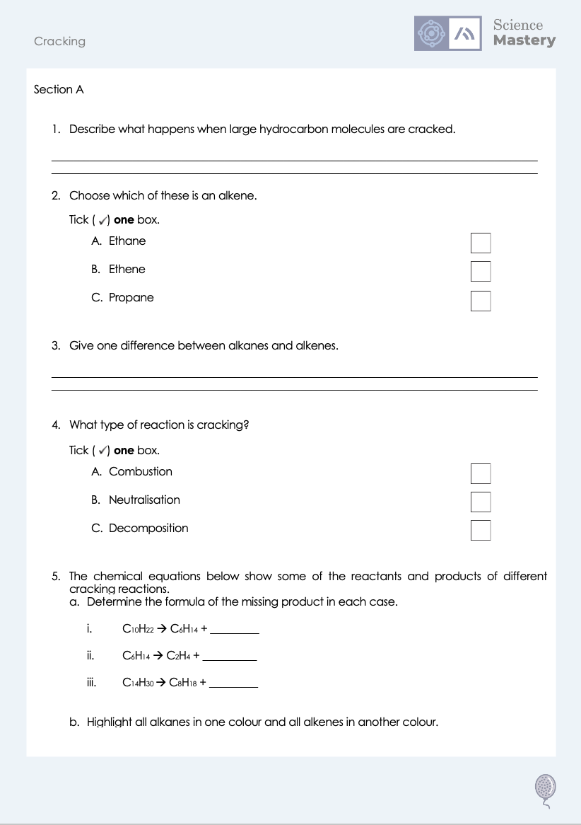
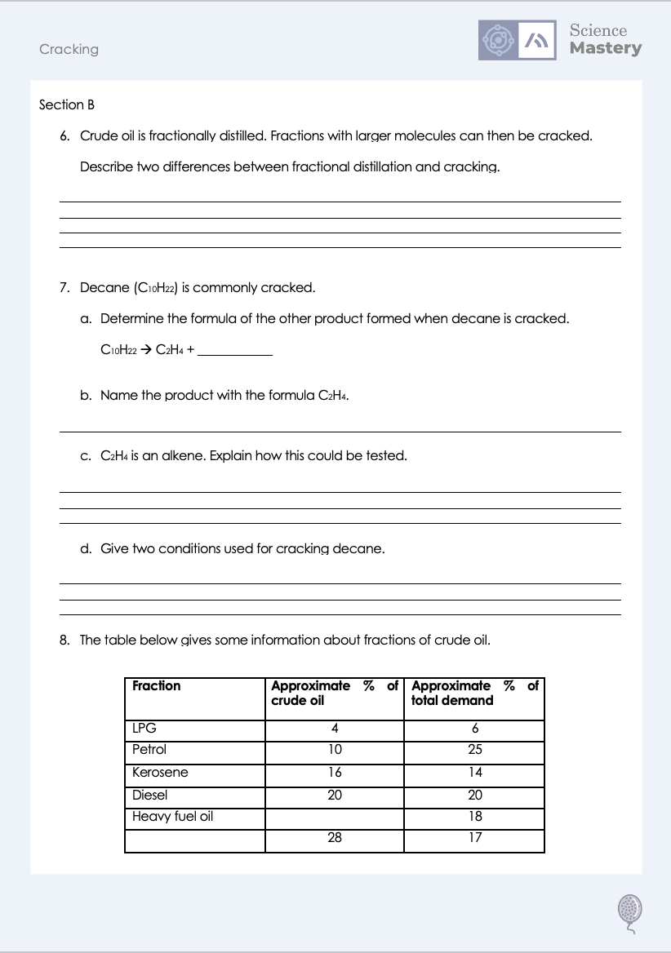
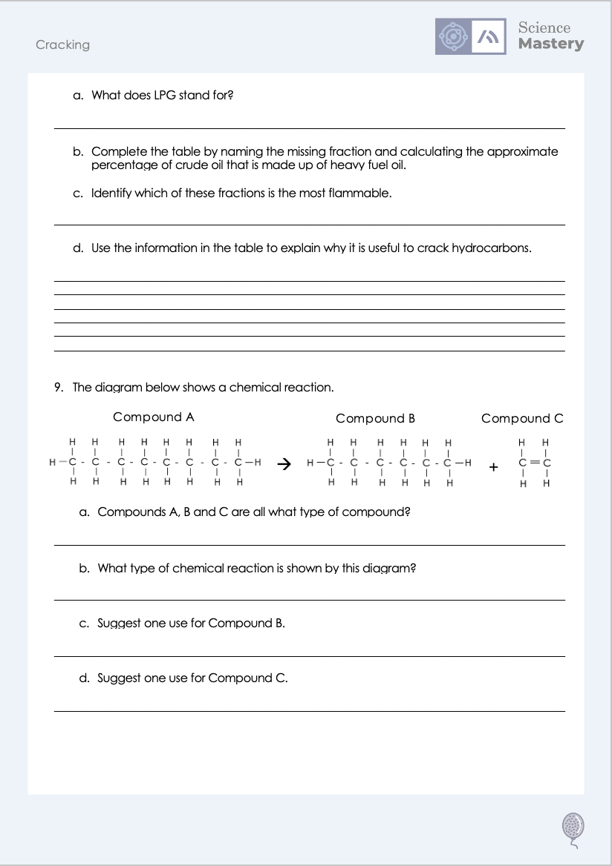
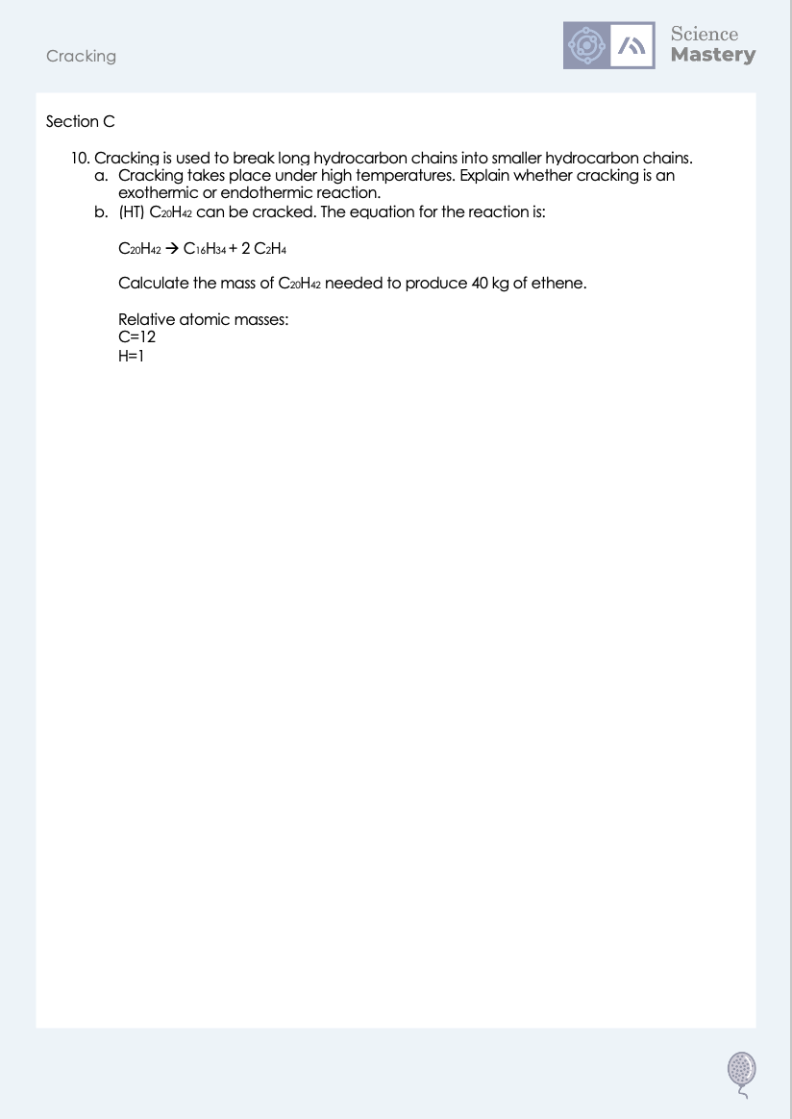
Worksheet

Slide 19
Answers
1. They are broken down to form shorter chain hydrocarbons and alkenes.
2. B - Ethene
3. Any one from:
Alkenes are unsaturated, alkanes are saturated
Alkenes contain a C=C double bond
Alkanes only contain C-C single bonds
Alkanes have the general formula C_{n}H_{2n+2}
Alkenes have the general formula C_{n}H_{2n}
4. C - Decomposition
5b. Alkanes and alkenes
C₁₀H₂₂ → C₆H₁₄ + C₄H₈
C₆H₁₄ → C₂H₄ + C₄H₁₀
C₁₄H₃₀ → C₈H₁₈ + C₆H₁₂
5ai. C₄H₈
5aii. C₄H₁₀
5aiii. C₆H₁₂

Slide 20
Answers
6. Any two from:
cracking uses a catalyst, fractional distillation doesn’t
cracking breaks up molecules, fractional distillation separates them
cracking is a chemical reaction, fractional distillation is a physical process
7a. C₈H₁₈
7b. Ethene
7c. Bromine water could be added to it, which would turn colourless.
7d. Any two from:
High temperature
Steam
Catalyst (accept zeolite, aluminium oxide)

Slide 21
Answers
8a. Liquefied petroleum gases
8b. Bitumen/residue
22 %
8c. LPG/liquefied petroleum gases
8d. To break longer chains into smaller chains where the demand is higher. For example, only 10% of crude oil is petrol but the demand for petrol is 25% of the total.
9a. Hydrocarbons
9b. Cracking
9c. Fuel/petrol
10. Feedstock for petrochemical industry/chemical reactions, for making plastics/polymers

Slide 22
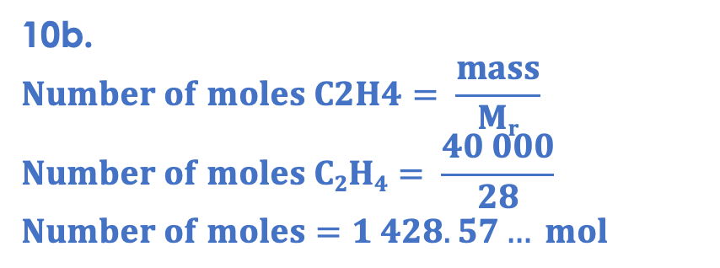
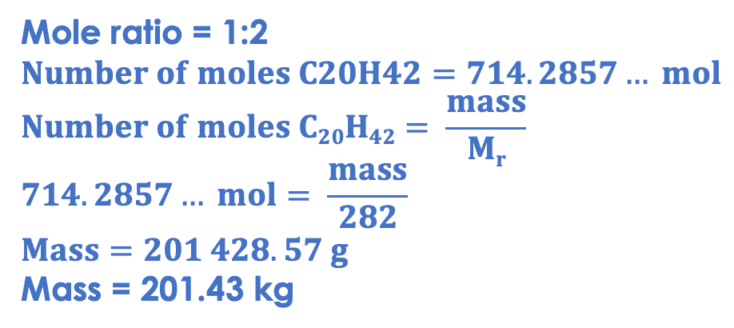
Answers
10a. It involves thermal decomposition, which is an endothermic reaction. More energy is taken in from the surroundings than is released through the reaction, which is why it has to take place at high temperatures.
10b.
$$Number of moles C2H4= \frac{mass}{Mr}$$
$$Number of moles C2H4= \frac{40 000}{28}$$
$$Number of moles=1 428.57… mol$$
Mole ratio = 1:2
$$Number of moles C20H42=714.2857… mol$$
$$Number of moles C20H42= \frac{mass}{Mr}$$
$$714.2857… mol= \frac{mass}{282}$$
$$Mass=201 428.57 g$$
Mass = 201.43 kg

Slide 23
Answer the questions below.
Which explains why cracking is useful?
A. It increases demand for shorter hydrocarbon chains
B. It increases supply of shorter hydrocarbon chains
C. It separates crude oil into different useful fractions
✓
What is the formula of the other product of this cracking reaction?
C₁₀H₂₂ → C₈H₁₈ + ________
A. C₂H₄
B. C₂H₆
C. C₁₈H₄₀
✓
What is the difference between alkanes and alkenes?
A. Alkanes have a C=C double bond
B. Alkenes have a C=C double bond
C. Alkenes contain more hydrogen atoms
✓
Notes:
Q1. Answer: B
If students answer A, they have confused supply and demand. If students answer C, they have confused the function of fractional distillation and cracking. To fix it, review what happens in both fractional distillation and cracking and show students how they are linked.
Q2. Answer: A
If students answer B, they have correctly calculated the number of carbons in the alkene but not the hydrogens, possibly trying to use the general formula for alkanes. If students answer C, they have added the numbers rather than subtracting. To fix it, give students further practice identifying the formulae of products of cracking.
Q3. Answer: B
If students answer A or C, they have confused alkanes and alkenes. To fix it, review the general formulae for alkanes and alkenes.

Slide 24
Lesson C5.1.5
What was good about this lesson? | What can we do to improve this lesson?
Send us your feedback by clicking this link
or by emailing sciencemastery@arkonline.org
Thank you!

